Slide 1


bUnit: a testing library components
Another embarrassing session…
December 16, 2022
Live webinar in Microsoft Teams
Luca Martini

Slide 2

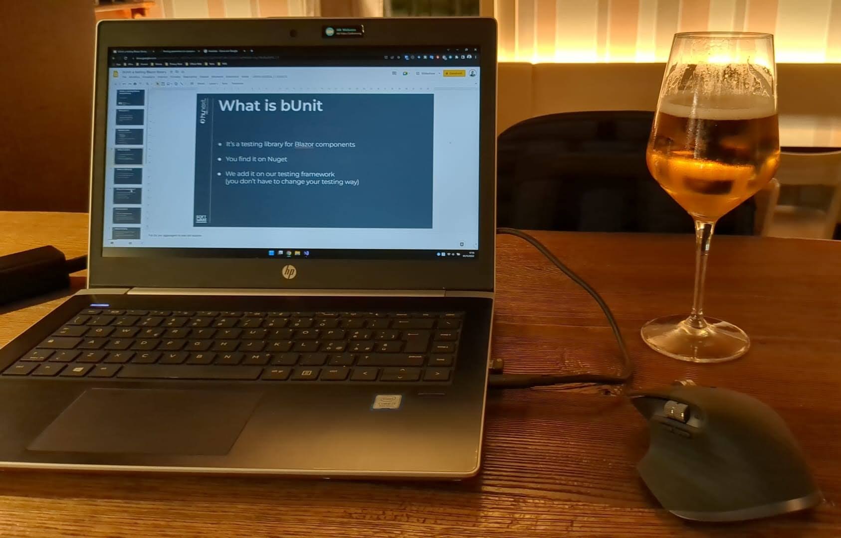
Pay attention
This session has been almost entirely written inside a bar :
it may contains explicit contents, personal opinions and evident errors
a lot of wine has been mistreated during its production
enjoy it easily like tasting a fresh glass of Prosecco

Slide 3

Who am I ?
I am the same person of the last year
I am developer grown up in Hunext Software who loves coding and joking
Recently I made a mistake: now I’m married

Slide 4
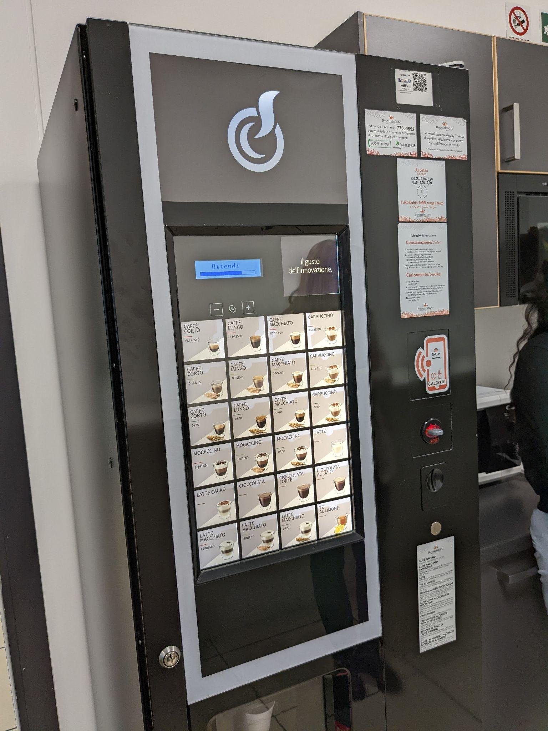
Session plan
What is bUnit and why is it necessary
How to use it :
Basic notions
Providing input
Interactions
Verifying output
Other (advanced) features
Is it useful ?
Resources & Contacts
…and obviously some code!
how good is this coffee ?

Slide 5

What is bUnit
It’s a testing library for Blazor components
It is available on Nuget
You can add it on your testing framework (you don’t have to change your testing way …maybe your code!)

Slide 6

What is bUnit (1)
It doesn’t run on browser (no JS…muahah !)
Very fast (milliseconds) like regular tests
It supports C# or razor syntax

Slide 7

Why is it necessary ?
Some features are difficult to test in Blazor components:
Components have life cycle methods
Parameters must be passed
Event handlers must be invoked
Orgasmic green check marks
the poor LG is worrying

Slide 8

How to use it
Install it: dotnet new --install bunit.template
Create a new bUnit project
Select unit test type: xUnit, NUnit or MSTest
Reference the project that contains components to test

Slide 9

Basic notions
C# or Razor syntax
Instance the component (you can use also the <text> notion)
Test context inheritance

Slide 10

Providing input
You can provide different types of input:
classic parameters (also two way binding)
cascading parameters
event handlers
RenderFragments
Easy dependency injection (classic modes)

Slide 11
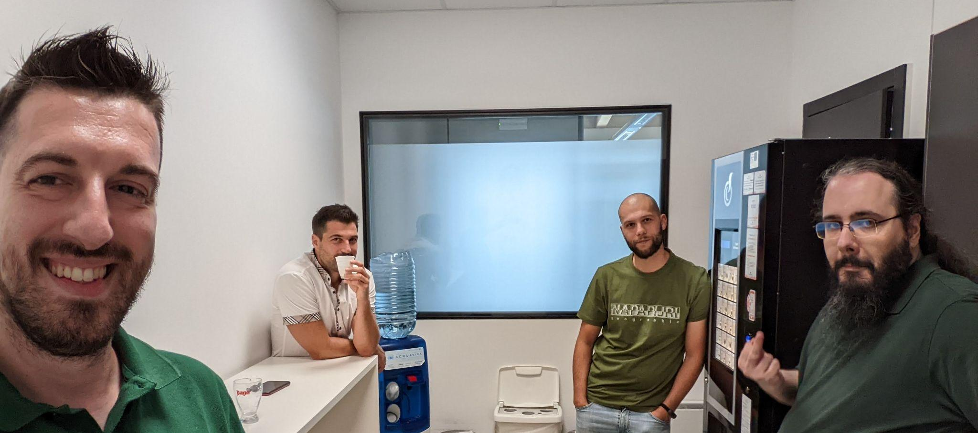

Interactions
Call component methods
Invoke event handlers
…what else ?

Slide 12

Interactions (1)
bUnit comes with helper that makes possible invoke all type of event handlers:
Clipboard events
Drag events
Focus events
General events
Input events
Keyboard events
Media events
Mouse events
Pointer events
Progress events
Touch event

Slide 13

Verifying output
Markup verification: verify the result on the browser
Component state verification: check property values and inner components
Command results check: (even on database)

Slide 14

Markup semantical comparison
Avoid HTML string comparison !
You can verify markup semantically: two markup snippets are equals if the browser result looks the same
You can also ignore some HTML elements and also use Regex

Slide 15

Other (advanced) features
FindComponent method for finding child components
Child control replacement with another (mock what you don’t need to test)
Faking authorization

Slide 16

So, is it useful ?
Classic test “limits”:
Long configuration time (huge dependency injection difficulties)
Testing markup is usually very hard (you must be able to identify UI elements)
It’s easier for simple projects, otherwise you have to write tests from the project’s beginning (Ufficio Web? mmm…)

Slide 17

Questions & Answers
Mmm…No…
Read the documentation !
…<<Arrrangiatevi>> !

Slide 18

Resources
https://bunit.dev the documentation is very comprehensive !
https://youtu.be/Co7QetPYiO4 a useful session that explains how we should write tests
https://github.com/lucamartiger/bUnitDemo the repository of this demo on github (essentially spaghetti code)

Slide 19



Contacts
You can find me in front of the Doctor!
Call me: we can drink a good coffee together!
lucamart@gmail.com
https://www.linkedin.com/in/luca-martini-2067a5197/

